Slide 1
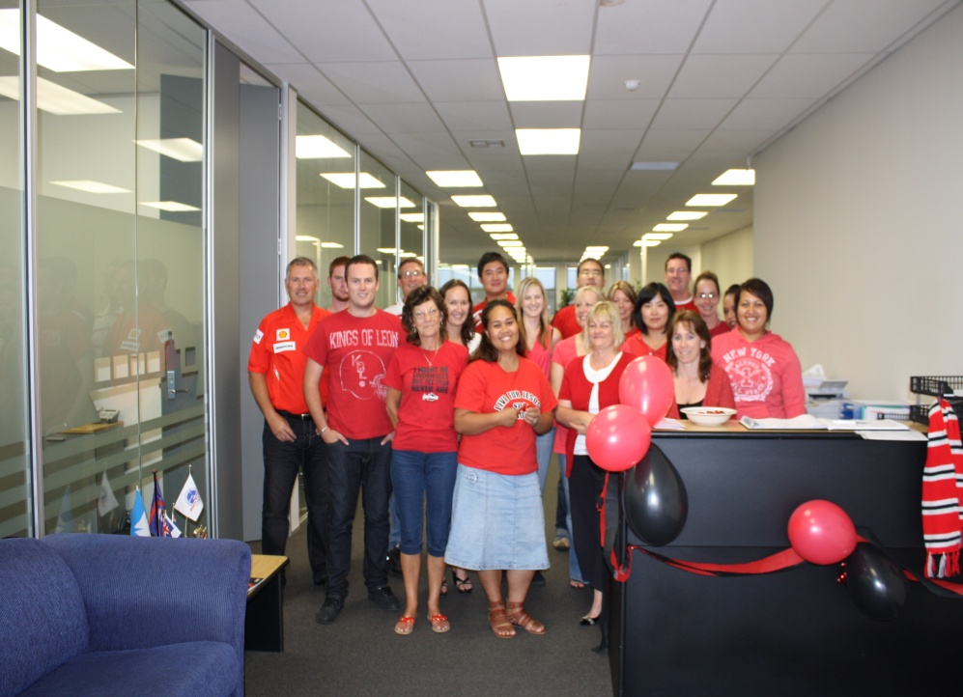
To our friends and colleagues in Canterbury –
Today Profreight along with all New Zealanders stand united in showing their support for our Cantabrian friends, families and colleagues.
Profreight Office Staff
We are dressed in Canterbury colours, and we are quietly hopeful that your boys will be victorious tonight!

Slide 2
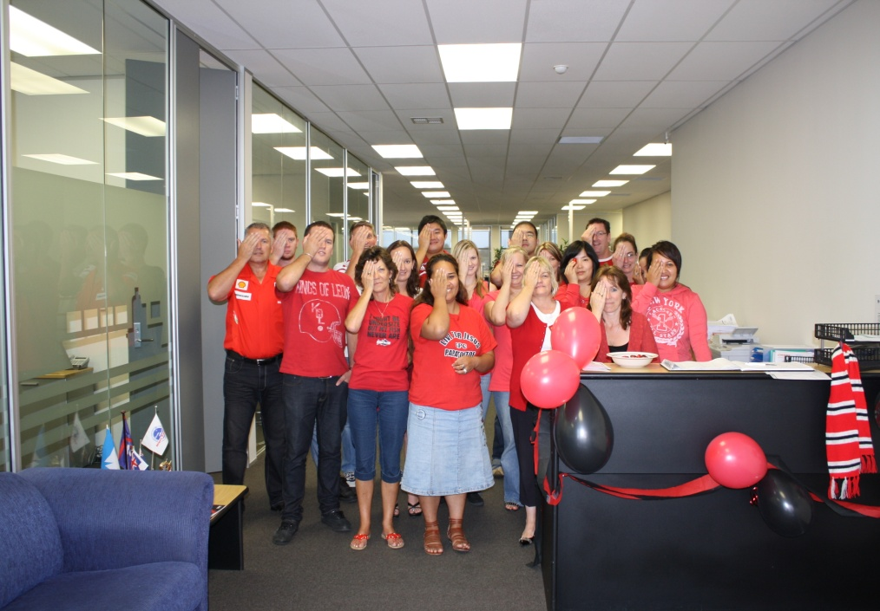
Temporary one eyed Cantabrians!
Our thoughts are truly with you all. Our staff have raised a substantial amount which will be donated to the appeal.

Slide 3
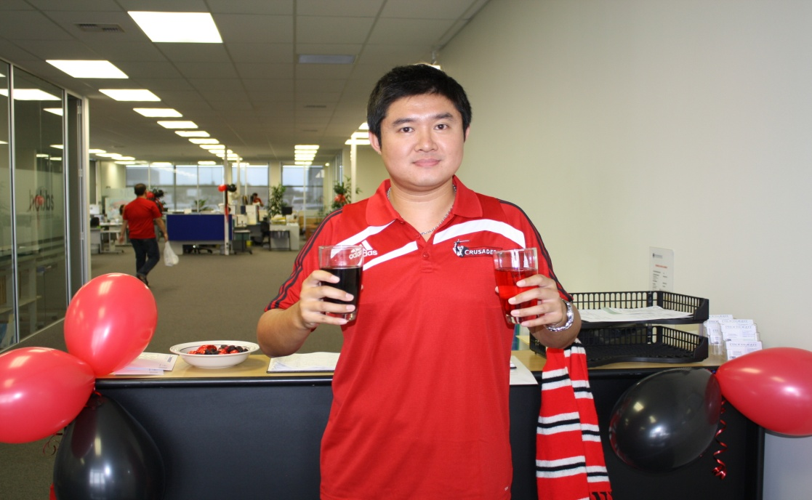
Every company has one!
PS: if any of you are considering moving north, you do realise of course it would require wearing Blue after today!

